Slide 1

KittyCoinAdventures
by Felix Steinhauser (b3) and Timo Huter (b3)
Final Presentation – 26.04.2024

Slide 2
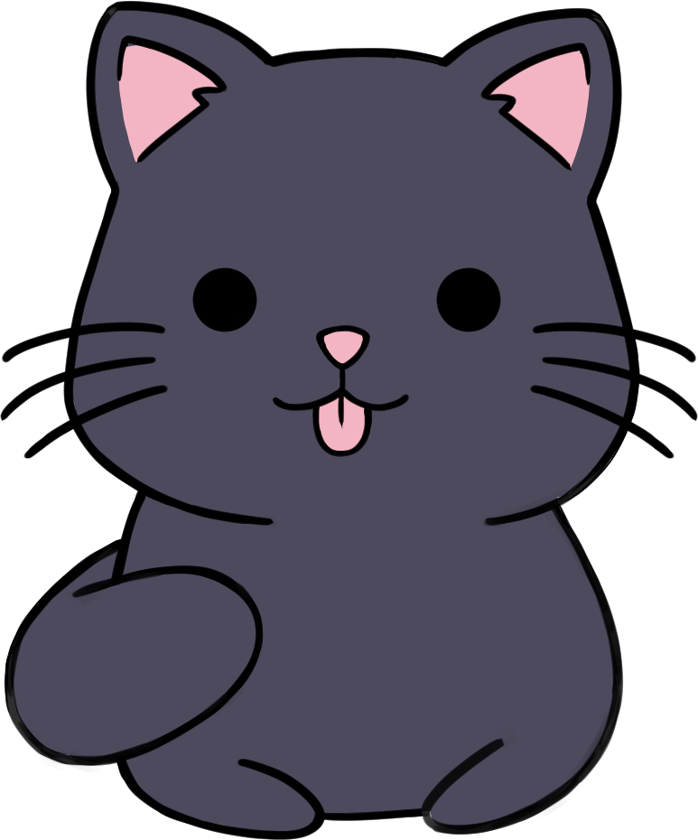
Agenda
Introduction (Team + Game)
Genre and Concept
Mechanic and Gameplay
Gaphic and Design
Development process
Live Demo
Future Features

Slide 3
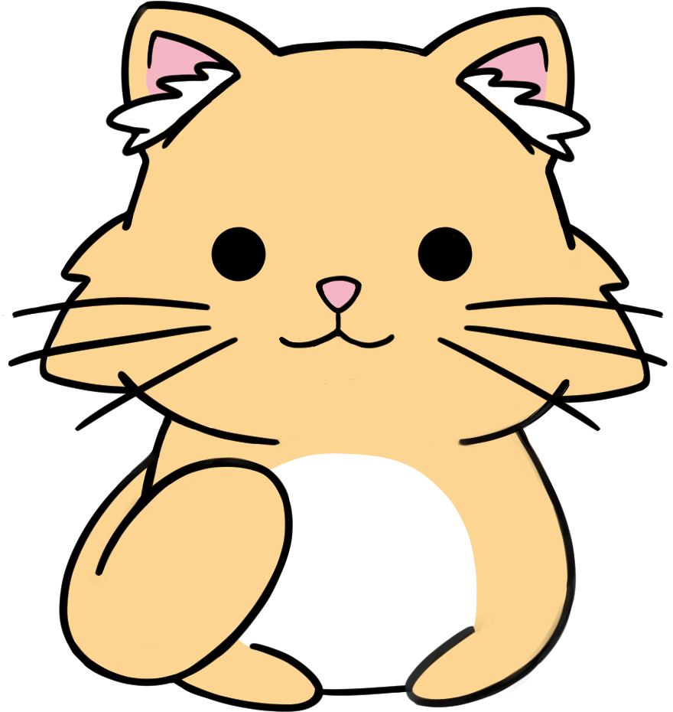
Introduction
Team:
Felix Steinhauser (B3)
Timo Huter (B3)
Game:
KittyCoinAdventures
Clicker / Idle Game
Optimized for Smartphones

Slide 4
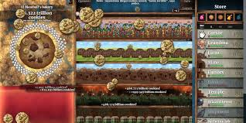
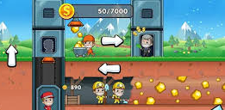
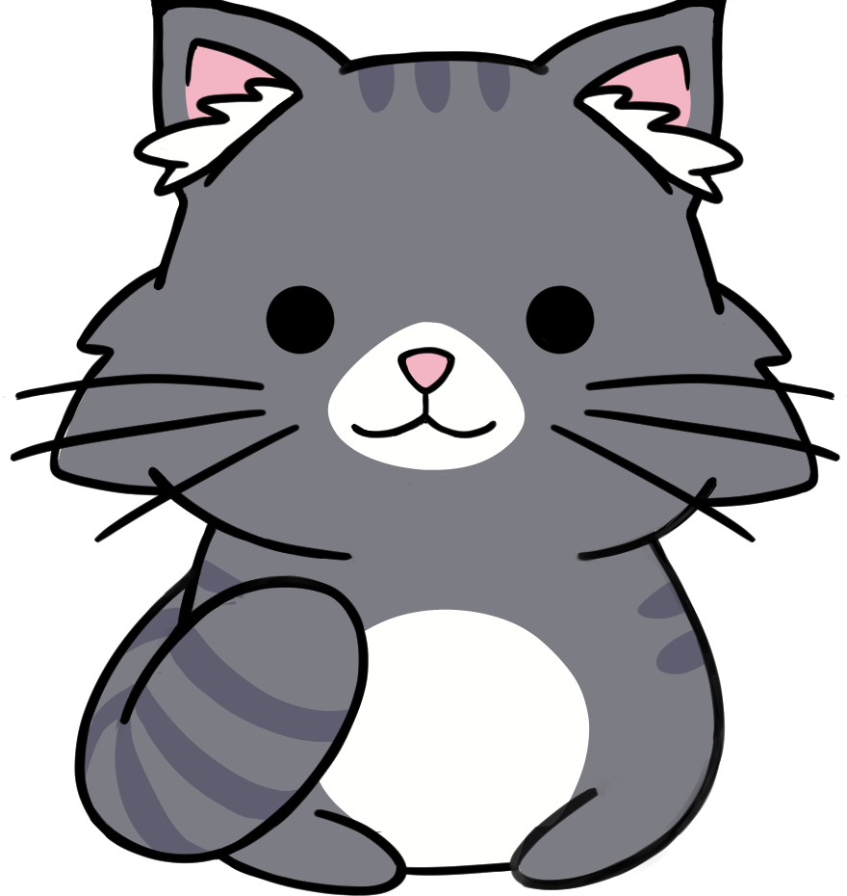
Genre
Clicker Games:
Repetitive clicking / tapping
Upgrades -> faster Progression
Satisfaction trough incremental growth
Idle Games:
Continuous progression
Rewads player for periodically playing

Slide 5
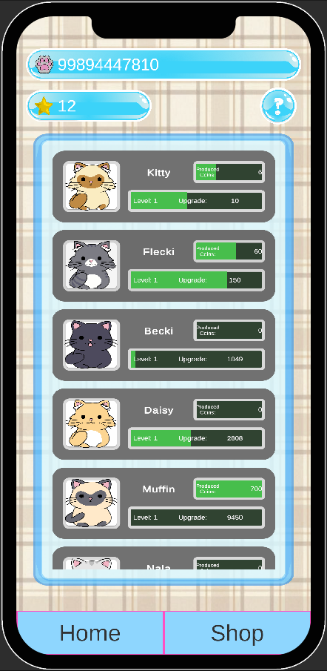
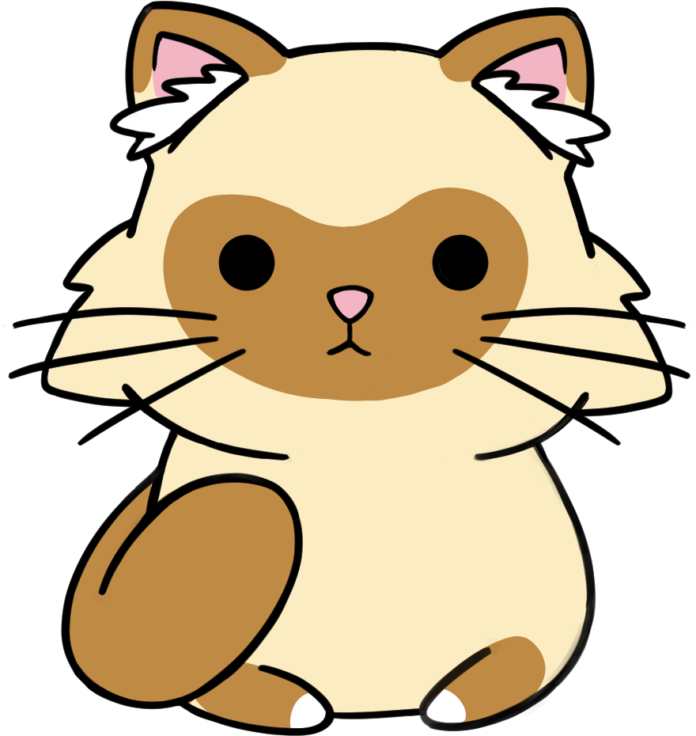
Our concept
Both genres combined
CATS
Cats -> KittyCoins -> Upgrades / more Cats
Each cat generates for 10 cycles
MainScreen / PersonalSpace / Shop
Accessoires for Cats to wear

Slide 6
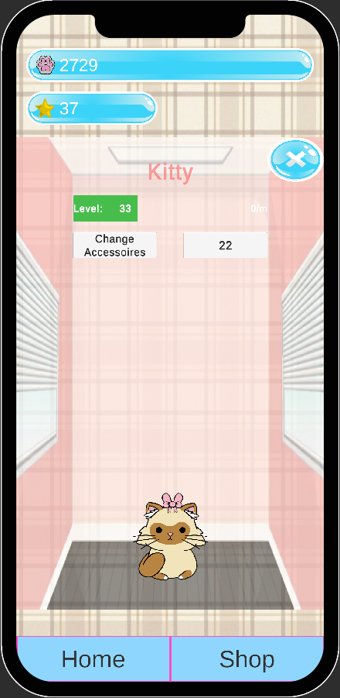
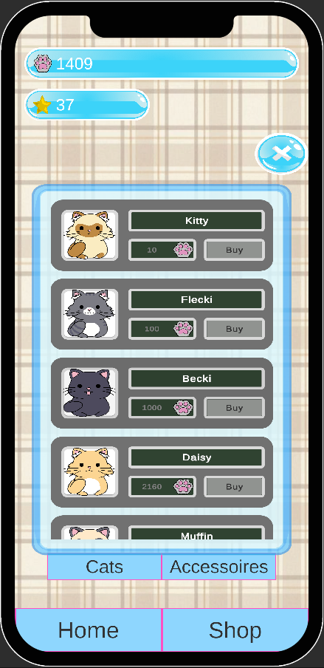
Graphic and Design
Optimized for smartphones
3 Screens
MainScreen
PersonalSpace
Shop
12 Cats
4 Accessoires

Slide 7

Development process
Generator class
Main screen
Visit cats
Accessoires class
Shop

Slide 8
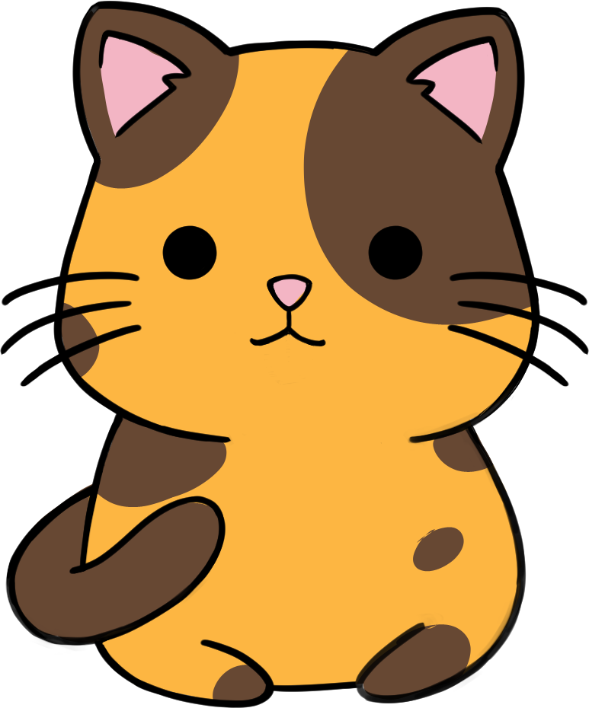
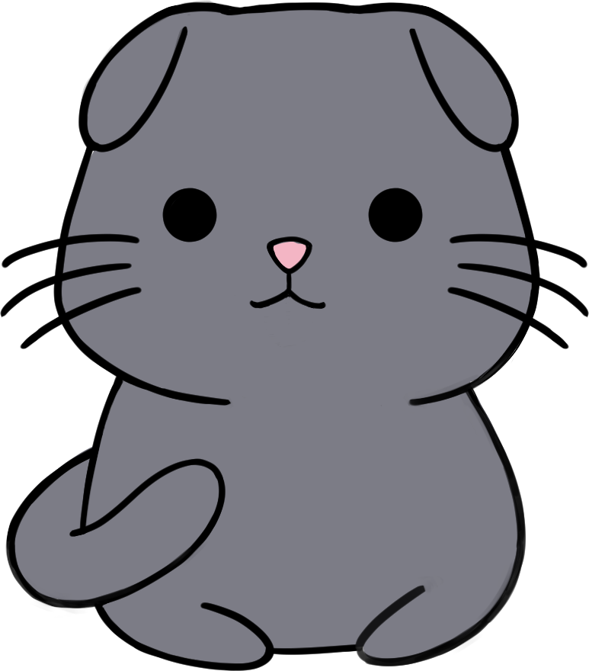
Live Demo

Slide 9

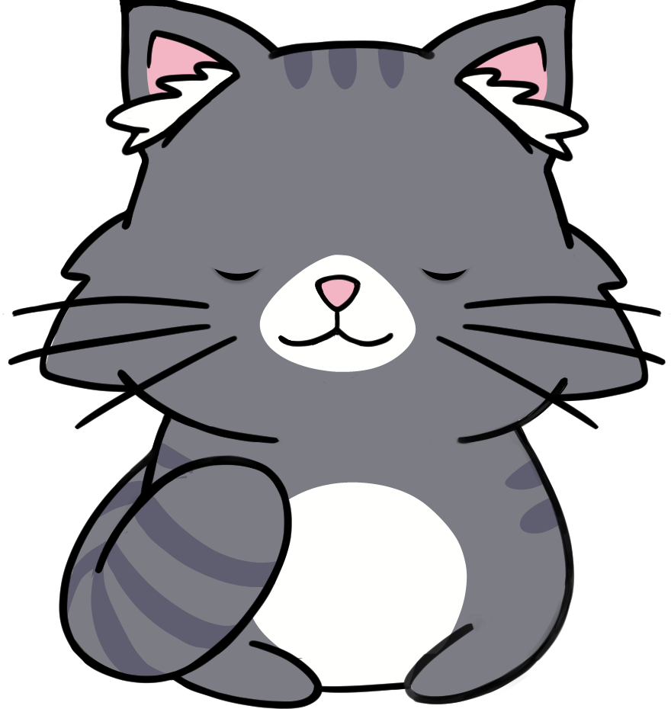
Future features
Changing sprites
Movement of cats
Minigames
New ways to acquire cats
Additional currency
Backstory

Slide 10


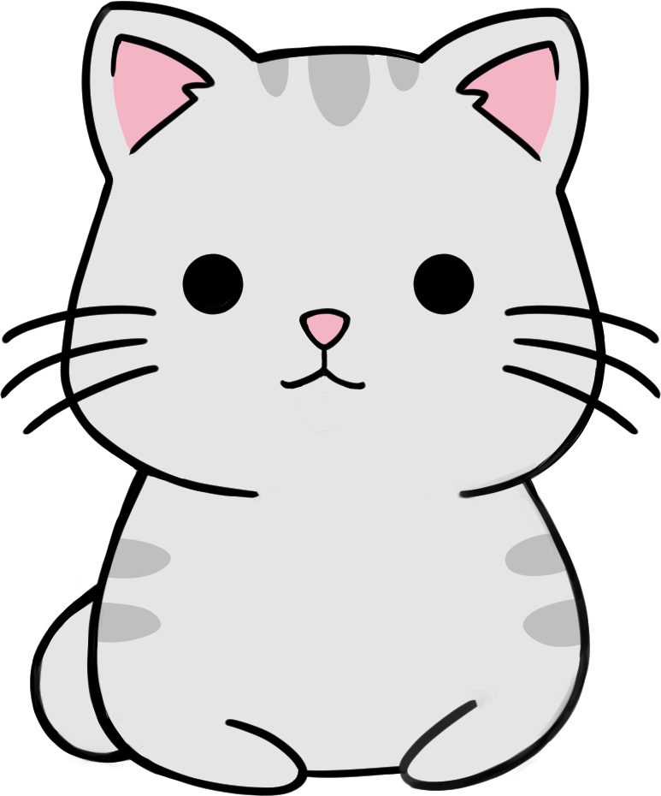

Thanks for listening
Any questions?

